Slide 1




₹upay
₹UPAY

Slide 2





01
OUR TEAM
Aakriti Mehta
Arya Madhani
Siddhi Somaiya
Romil Lodaya

Slide 3


02
CONTENT
01
02
03
04
05
06
Problem Statement
Introduction
Objetives
Future Implementations
Implementation
Conclusion

Slide 4


03
PROBLEM STATEMENT
Financial wellness Platform for Individuals and Families
Despite the availability of various financial instruments, individuals struggle to manage their finances efficiently, especially when it comes to investments and savings, providing users with a centralised platform to manage their investments, savings, and overall financial well-being.

Slide 5


04
INTRODUCTION
The primary purpose of the wellness platform is to streamline financial management and provide users with the insights and support they need to make informed decisions about their money. By offering a range of features and functionalities tailored to the diverse needs of our users, we aim to promote financial literacy, encourage responsible financial behavior, and ultimately improve the overall financial well-being of individuals and families.
INNOVATION
To provide personalized financial insights tailored to each user's unique financial situation and goals. By analyzing spending patterns, investment preferences, and life stage, we offer actionable recommendations to optimize financial decisions and maximize outcomes.

Slide 6





05
OBJECTIVES
Dashboard: Real-time overview of finances.
Expense Tracking: Categorize spending for insights.
Budgeting: Track and manage expenses.

Slide 7



06
OBJECTIVES
04
05
06
Family Financial Management: Enable users to add family members and their investments for a holistic view of the family's finances.
Net Worth Calculation: Include a net worth calculator considering assets, liabilities, and insurance for an accurate financial assessment.
Risk Assessment: Implement a feature to evaluate the risk of different investments and provide insights into cumulative risk exposure.

Slide 8


07
Future Scalability
CHATBOT
01
SCANNER
02

Slide 9


08
IMPLEMENTATION
SNAPSHOTS OF WORK DONE

Slide 10

09

Slide 11

10

Slide 12
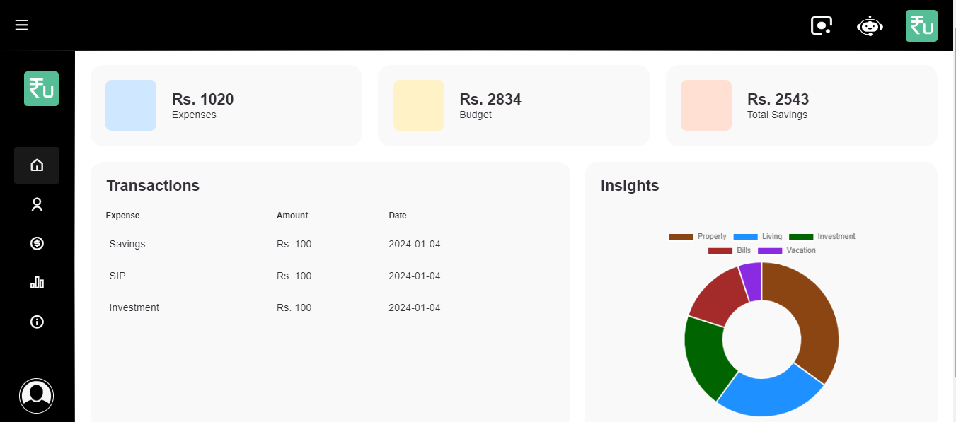
11

Slide 13
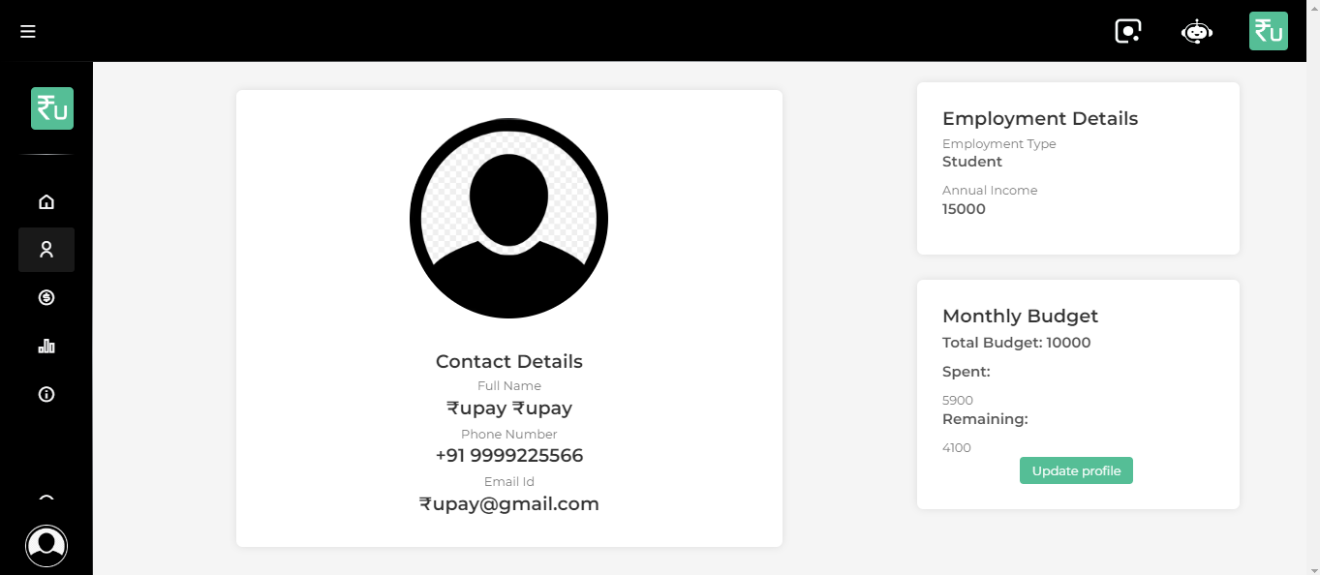
12

Slide 14
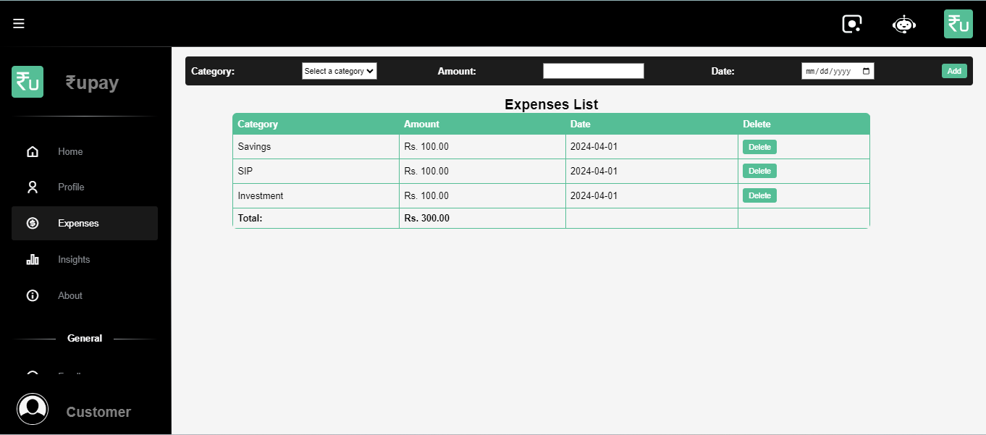
13

Slide 15
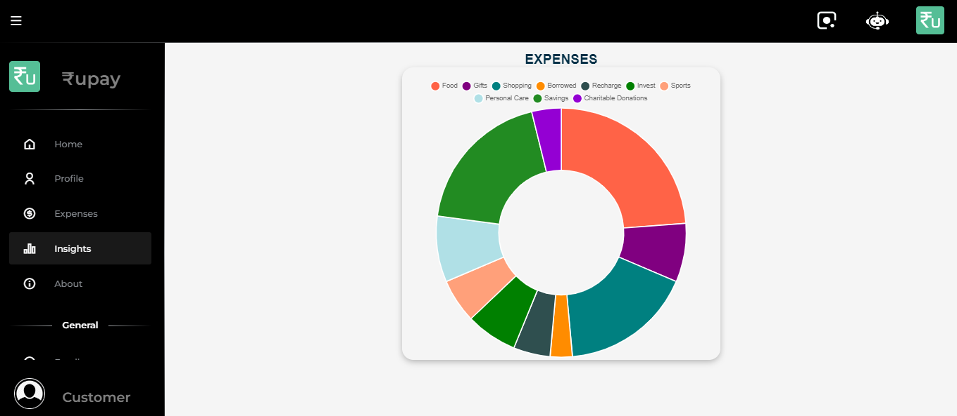
14

Slide 16
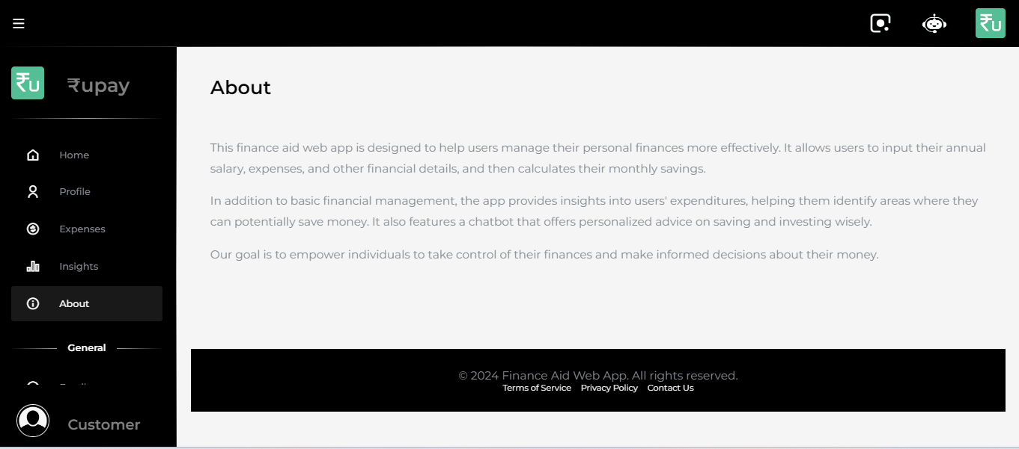
15

Slide 17
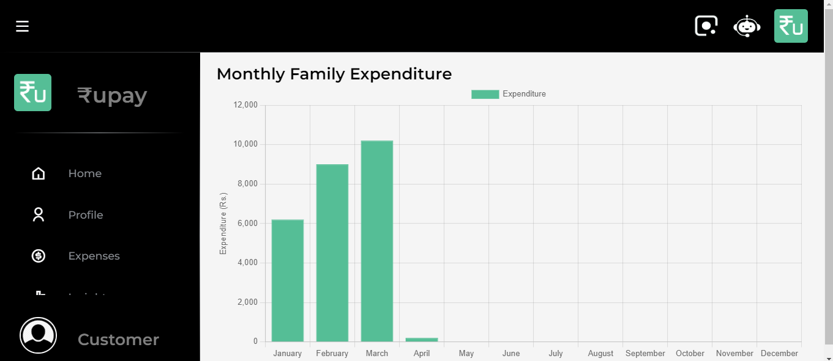
16

Slide 18
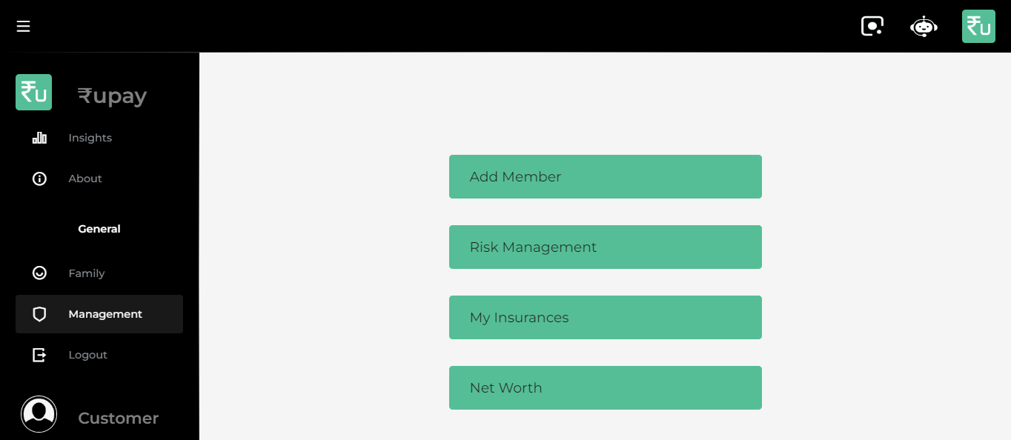
17

Slide 19
18

Slide 20
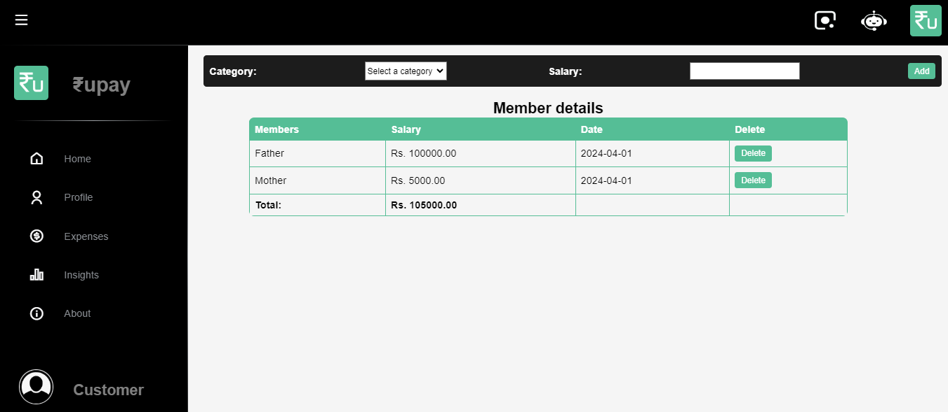
19

Slide 21
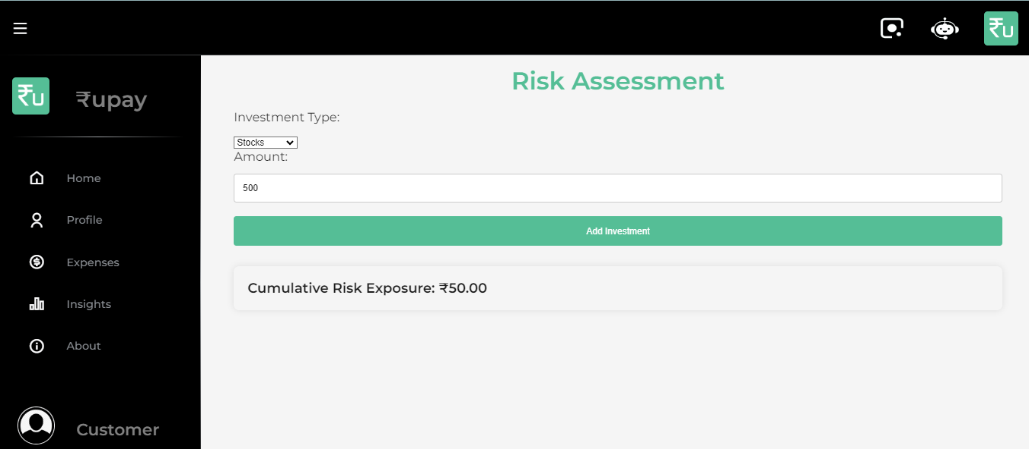
20

Slide 22
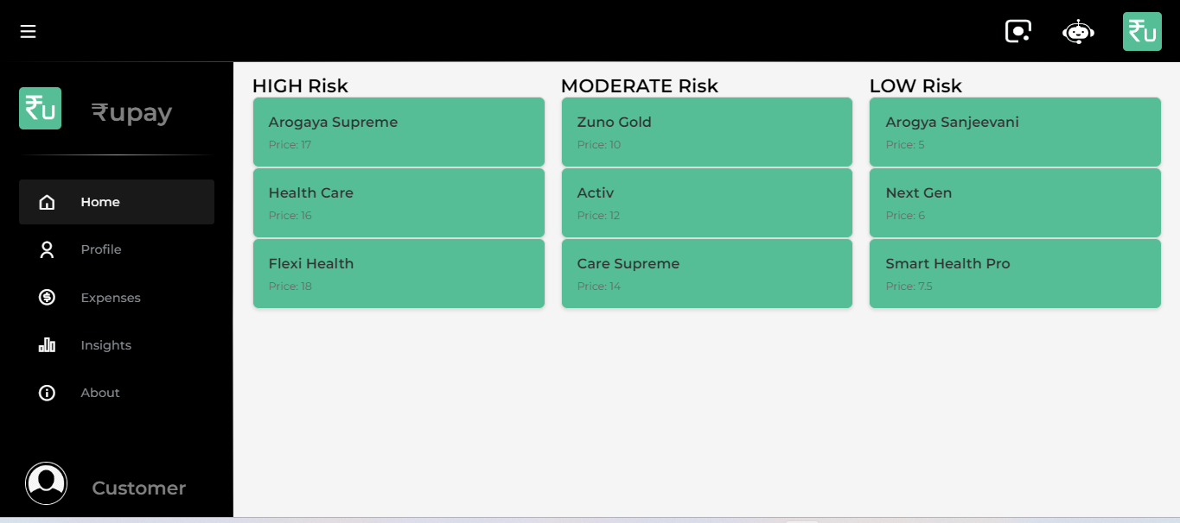
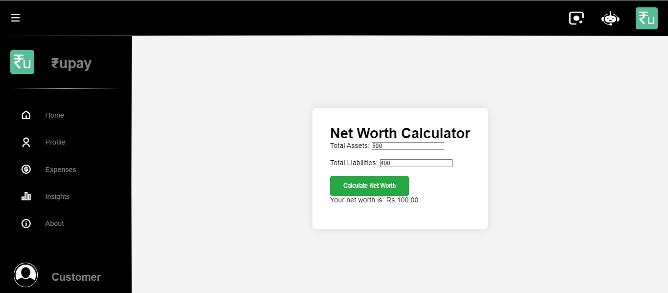
21

Slide 23
22
CONCLUSION
Our web app for finance tracking offers a comprehensive solution to empower users in managing their finances effectively. With features for budgeting, investment management, savings goals tracking, and financial education, it equips individuals and families with the tools they need to make informed decisions and build financial wellness. Join us on this journey towards financial empowerment and a brighter financial future.

Slide 24

THANK YOU!

